Slide 1



POC for song recommendation engine
Members of Group-6
Prajwal kale
Abhishek uttam chaudar
Ms. reshma
Navara sridarshini
Mohammed Fayaz Ahamed
Kondavalasa bhavitha

Slide 2
Content
Introduction
Data set overview
Models building
Conclusion & Recommendations
EDA
App

Slide 3

Introduction
Welcome to the project of presenting a proof of concept for a Song Recommendation Engine. This groundbreaking technology combines the power of machine learning and data analysis to build a recommendation application like never before.

Slide 4

Data Set Introduction
The data set we use to build this amazing application was acquired from the Spotify app.
The data set bares a records of more than 170K with 16 columns
The dataset was in the csv file format.
The crucial task from the data set is to select those features which will provide the best performance in giving the recommendations.

Slide 5
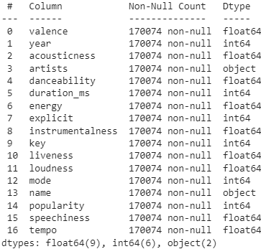
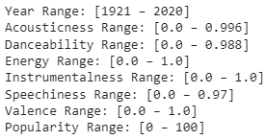

Exploratory Data Analysis (EDA)
The primary task involved in this step is to understand the data set and perform the data quality checks such as removing the duplicates, missing values handling, type casting and checking the values lies in the range.

Slide 6
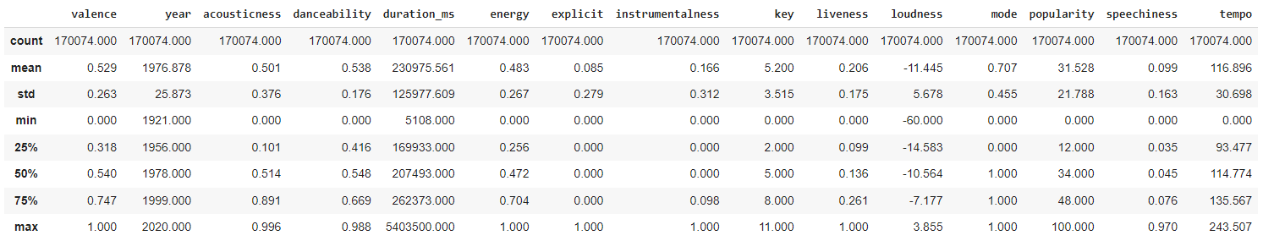
Exploratory Data Analysis (EDA)
Descriptive Statistics with the terms count, mean, Standard deviation, Minimum value, Maximum value, 1st, 2nd, 3rd quartile.

Slide 7
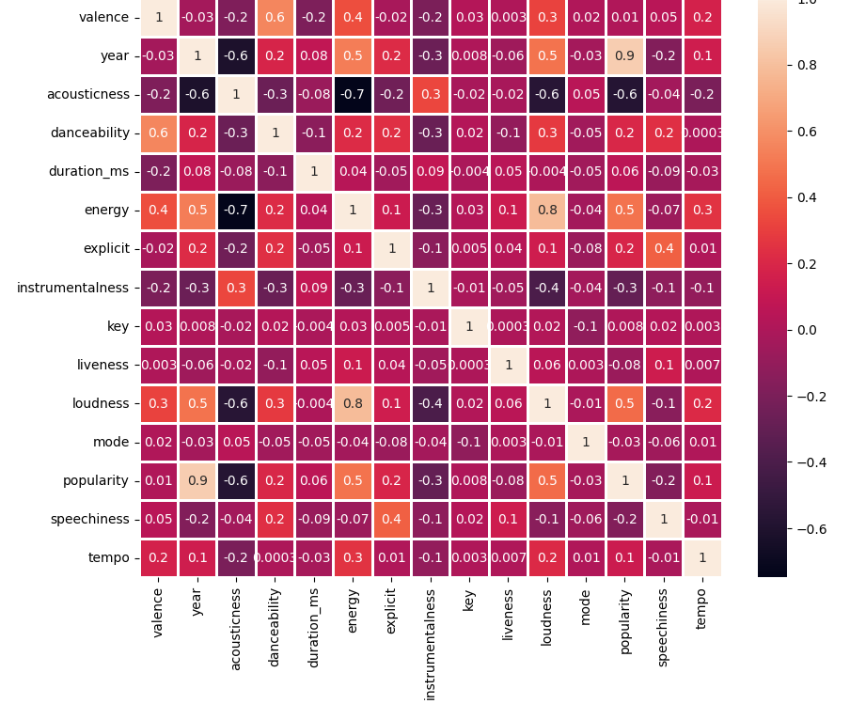
Exploratory Data Analysis (EDA)
Correlation of each variables.
Found out that the year variable is highly correlated with the popularity.

Slide 8
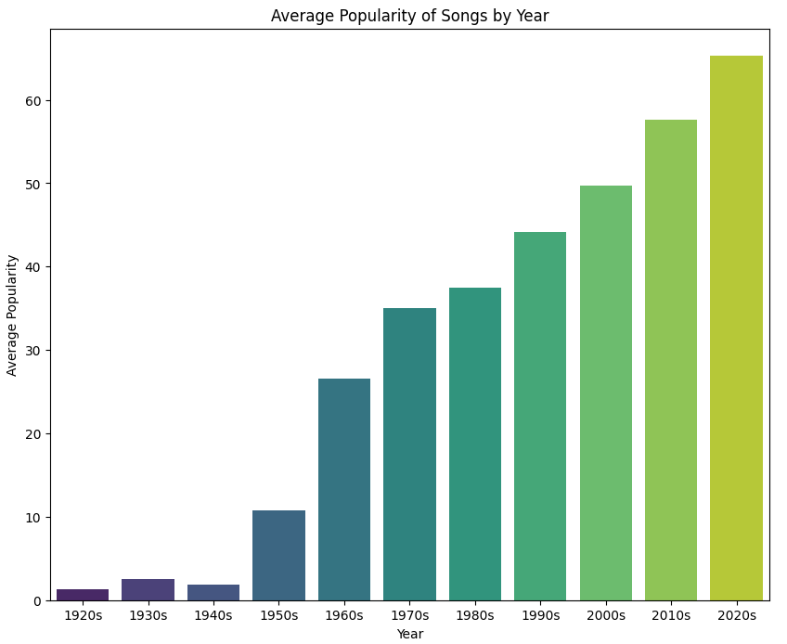
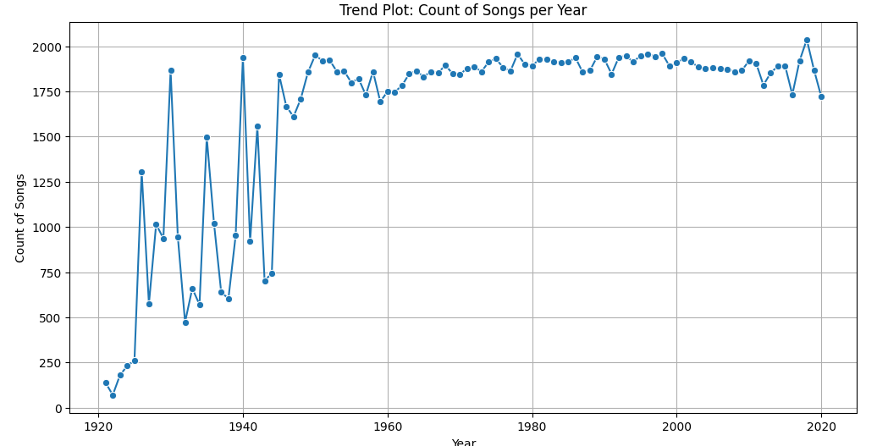
Exploratory Data Analysis (EDA)
Data Visualization: Year – wise
From this we gain an understanding that the songs produced and become popular are higher in the later years. So, we have now focused on the dataset where the year is greater than 2000.

Slide 9
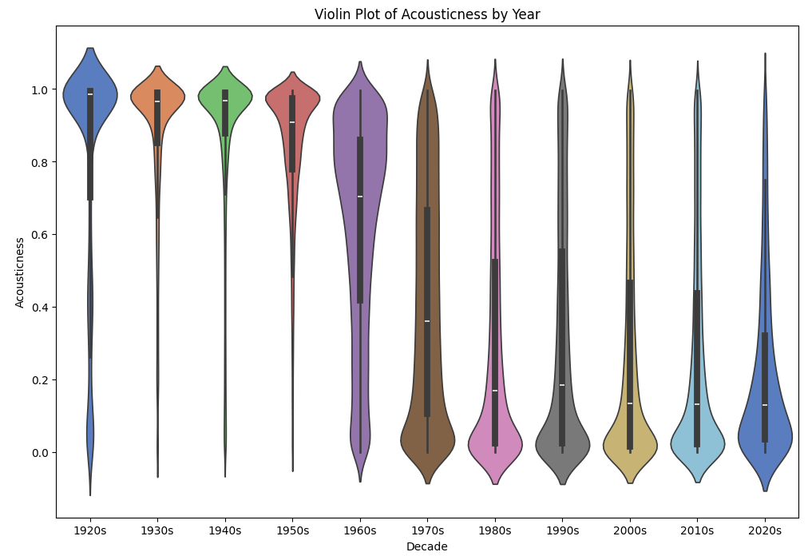
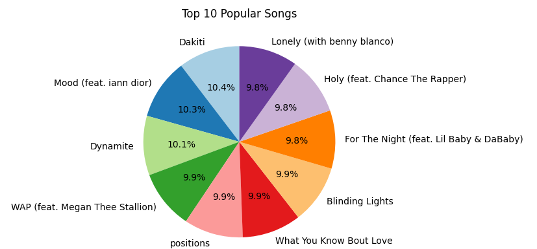
Exploratory Data Analysis (EDA)
Data Visualization: Year – wise
From this we gain an understanding that the acousticness of the
Songs was reducing. May be due to the inventions of new technologies in the later years.

Slide 10
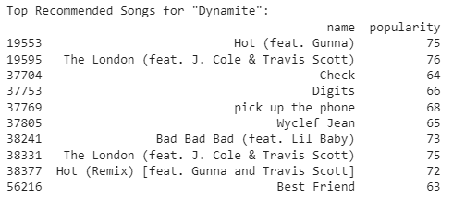
Model Building
Cosine Similarities
Cosine similarities are a mathematical technique used in song recommendation engines to measure the similarity between two songs. By calculating the angle between two vectors representing songs, the engine can determine how closely related they are in terms of musical features. This method allows for accurate and personalized song recommendations, enhancing user satisfaction and discovery.
As we can see in the results for the song name ‘Dynamite’, It is recommending the songs with popularity between 63 – 75 but the song ‘Dynamite’ have the popularity of 97.

Slide 11
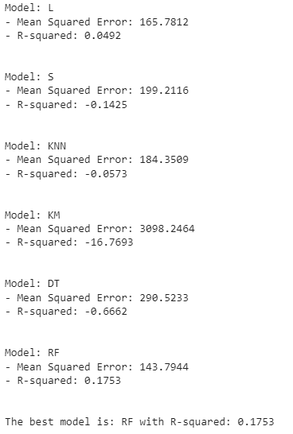
Model Building
Machine learning Algorithms
Machine learning algorithms play a crucial role in enhancing the accuracy and effectiveness of song recommendation engines. These algorithms analyze user preferences, behavior, and feedback to generate personalized recommendations.
From the cosine similarities we found the model lacks in the accuracy. So, we try to using different machine learning algorithms such as Linear Regression(L), Support vector Regressor(S), KNN, K-means clustering(KM), Decision Tree(DT) and Random Forest(RF).
We got a conclusion that the Radom forest is the best model with good predictions.

Slide 12
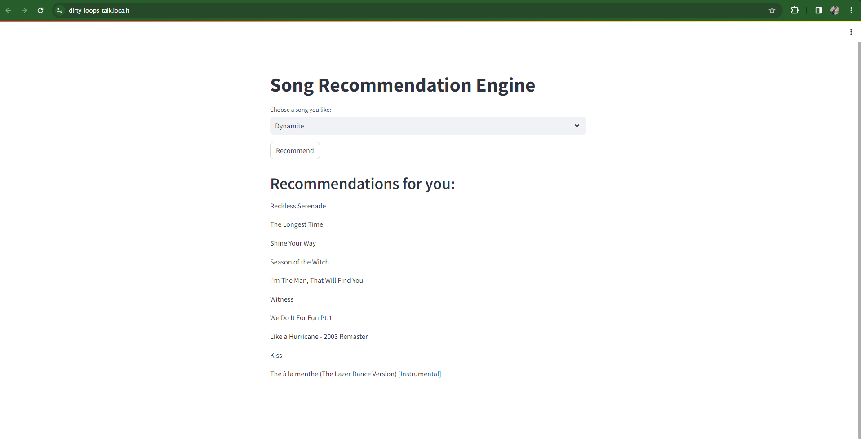
Song Recommendation Application
With the help of the stream lit library, we have created an application which gives us ten songs as recommendation for the user using the random forest model as backend predictions.

Slide 13
Conclusion & Recommendations
After implementing various machine learning algorithms such as cosine similarities, linear regression, support vector regressor, KNN, K-means, decision tree, and random forest in our proof-of-concept (POC) song recommendation engine, we have determined that the Random Forest model consistently provides the most accurate and effective recommendations. Random Forest excels in handling complex datasets with numerous features, making it well-suited for our application's needs. Its ability to handle non-linear relationships and high-dimensional data ensures robust performance in recommending songs tailored to users' preferences.
Based on our findings, we recommend utilizing the Random Forest model as the primary recommendation algorithm for our song recommendation engine app. However, to enhance the recommendation system further, we suggest integrating techniques such as collaborative filtering and matrix factorization to complement the model's capabilities. Additionally, ongoing monitoring and evaluation of the recommendation system's performance are essential to ensure continued accuracy and user satisfaction. By leveraging Random Forest and continuously refining our approach, we can deliver personalized and engaging song recommendations that cater to each user's unique tastes and preferences.

Slide 14

Thank you

